Slide 1

LECTURE-1
BT101-Introductory Biology
Dr. Kusum K. Singh
Department of Biosciences and Bioengineering
Indian Institute of Technology Guwahati

Slide 3
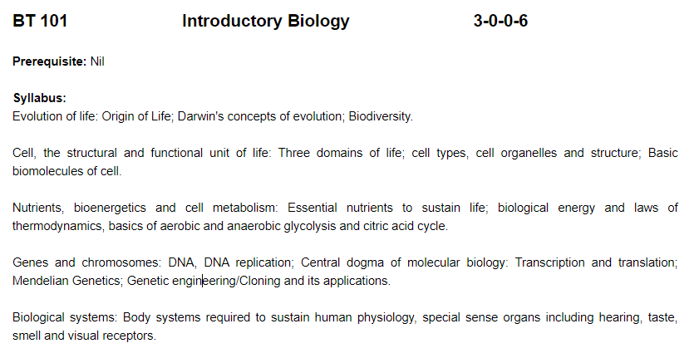
Course Content
BT101 Introductory Biology (3-0-0=6)

Slide 4





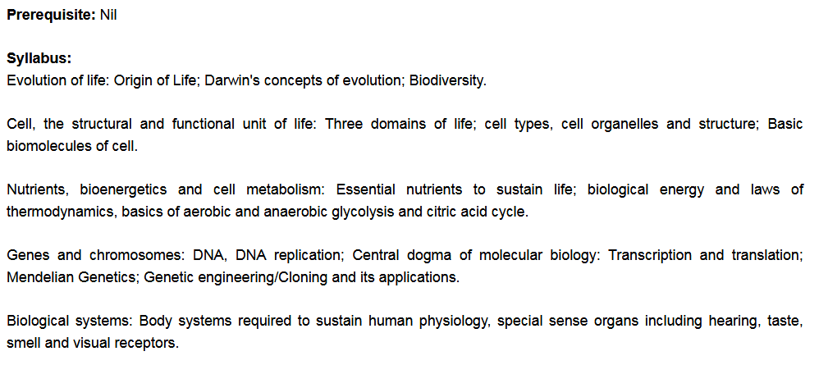
Course Content
BT101 Introductory Biology (3-0-0=6)

Slide 5
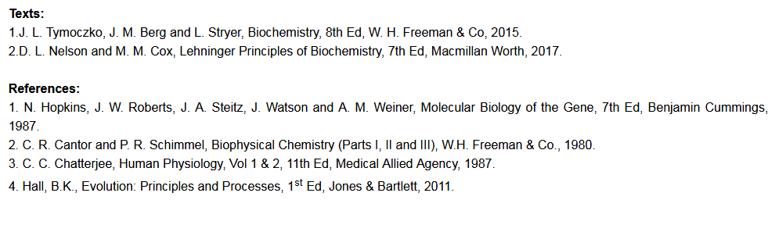
Course Content
BT101 Introductory Biology (3-0-0=6)

Slide 6
Course Content
BT101 Introductory Biology (3-0-0=6)
Flow of teaching : Mendelian Genetics; Genes and Chromosomes: DNA; Central Dogma: Replication, Transcription and Translation; G.E: cloning steps; Applications of cloning.

Slide 7
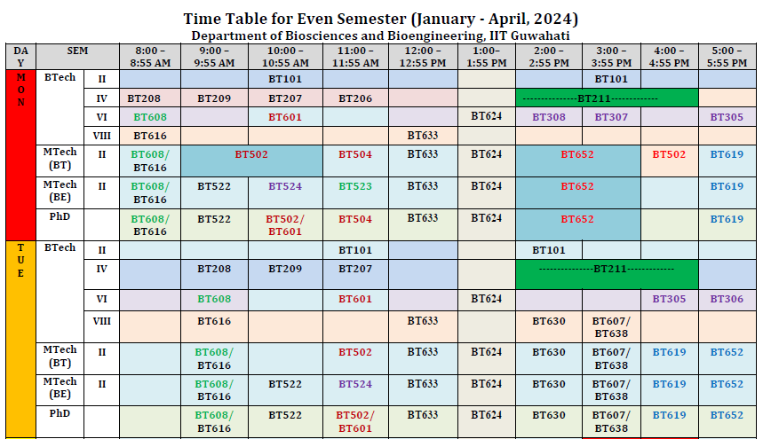
Lecture Schedule

Slide 8
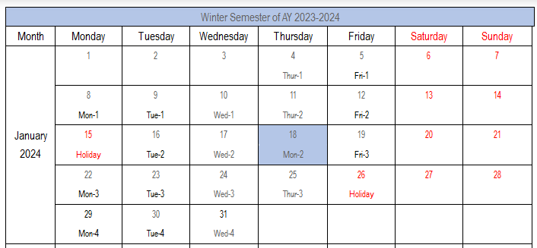
Lecture Schedule

Slide 9
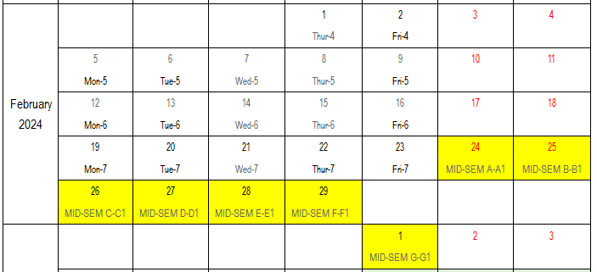
Lecture Schedule

Slide 10
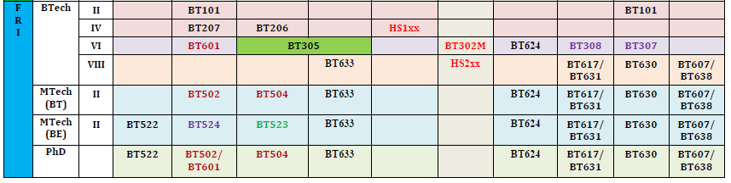
Lecture Schedule

Slide 11
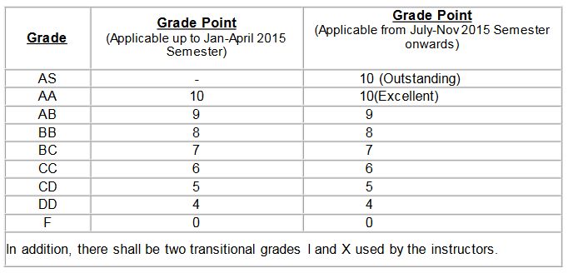
Course Grading Scheme
There will be ONLY Mid and End semester examinations
The Mid-semester had a weightage of 50 %.
The End-semester will have a weightage of 50 %.

Slide 12
Rules and Regulations
Lectures, it’s scheduled according to the time table.
A student will be debarred from appearing in an examination if his/her attendance falls below 75 percent.
There will NOT be any re-quizzes or re-mid-semester examination.
Don’t copy or cheat in mid- & end-sem. If caught you will be penalised appropriately.

Slide 13
Mendelian Genetics
Contents:
Who was Mendel?
What did he do?
What were his observations?
Conclusions from his experiments.
Mendel’s Law.

Slide 14
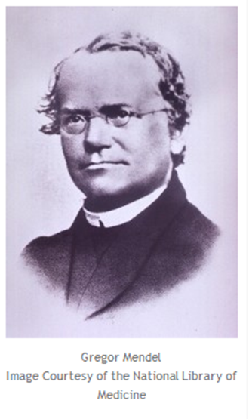
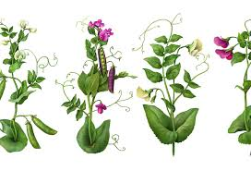
Mendelian Genetics
Who was Mendel?
He obtained his studies & trainings in Maths and Physics from University of Bruṅṅ and Vienna.
For the first time in history, he carefully conducted series of detailed experiments on pea (pisum sativum) for entire 8-10 years in more than 28000 plants and presented his results in Brünn conference. (Reference: Annotated PDF article).

Slide 15
Mendelian Genetics
What did Mendel do?
He developed the principle of inheritance by performing exp. on pea plants.
Inheritance: means characteristics passed down to individuals.
Prior to Mendel: it was believed that inheritance was due to a blending of parental “essence” → mixing blue + yellow = green.
Mendel however, believed in discrete units of inheritance factors (or gene).

Slide 16
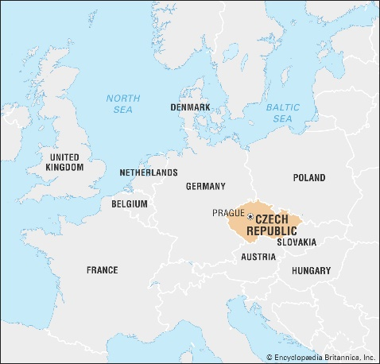
Mendelian Genetics
Who was Mendel?
Mendel was born on 20th July 1822, at the Moravian-Silesian (today’s Czech Republic).
He was named Johaan Mendel. Later, for obtaining easier formal education he joined Augustinian monks and there he was given the name Gregor Johaan Mendel or famous Gregor Mendel.

Slide 17
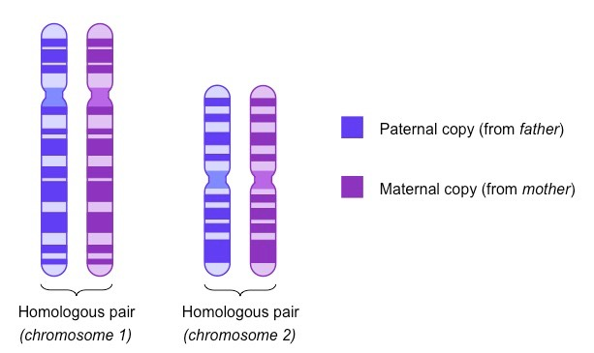
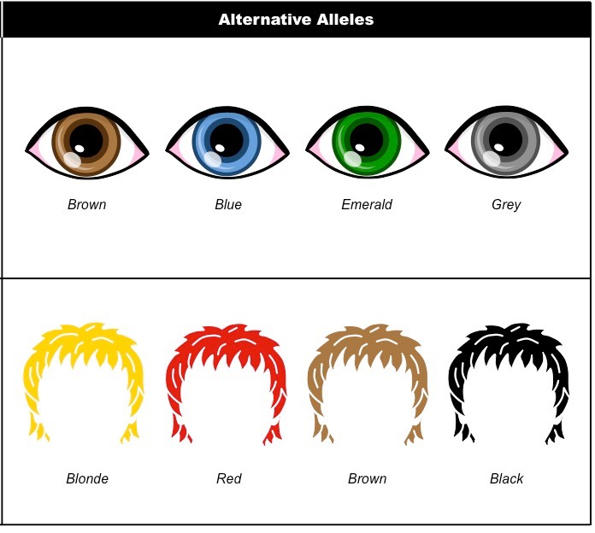
Mendelian Genetics
Some terminology

Slide 18
Mendelian Genetics
What did Mendel do?
He crossed different varieties of pure bred pea plants, then collected seeds to determine their characteristics.
Pure bred/True bred: when two pea plants were crossed the progeny showed consistent, replicable and predictable characteristics.

Slide 19
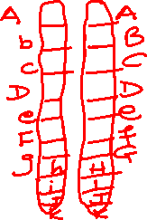
Mendelian Genetics
For any trait, an individual inherits one gene from each parent so that has pairing of two genes (alleles).
Two alleles that form the pair for a trait are identical, then the individual is said homozygous.
If two alleles are different = heterozygous.
Some terminology

Slide 20
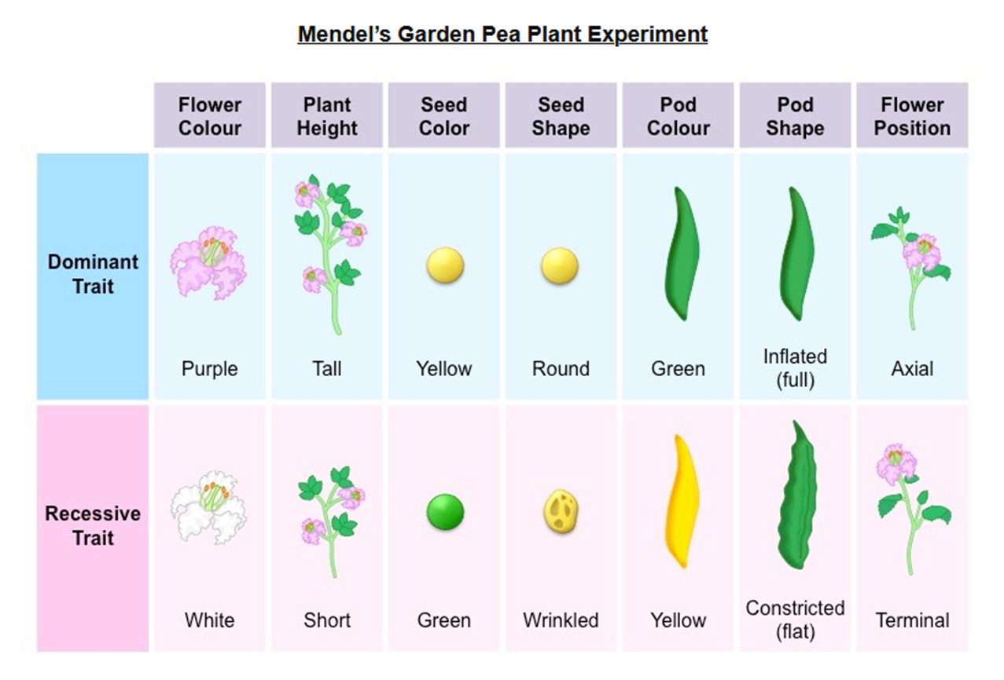
Mendelian Genetics
What did Mendel do?
Characters selected for experiment relate:

Slide 21
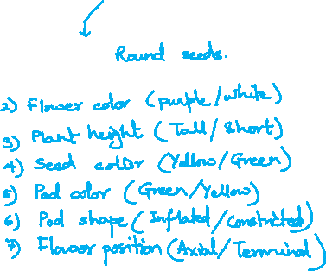



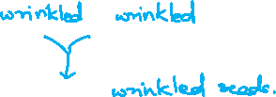
Mendelian Genetics
What did Mendel do?
Characters selected for experiment relate:

Slide 22

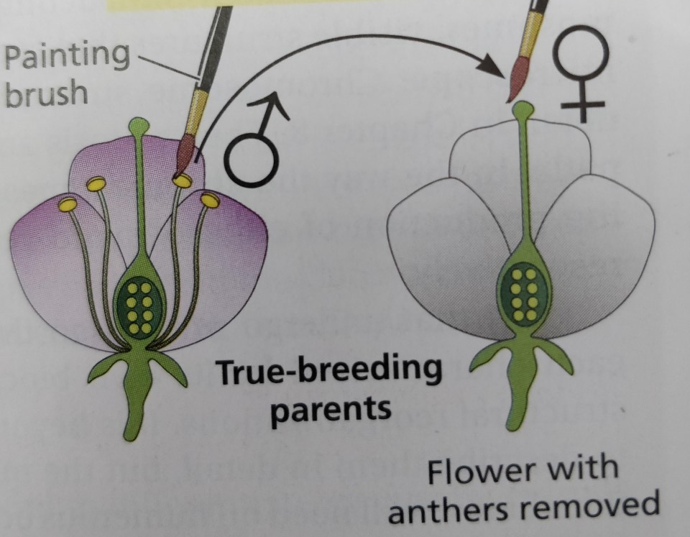
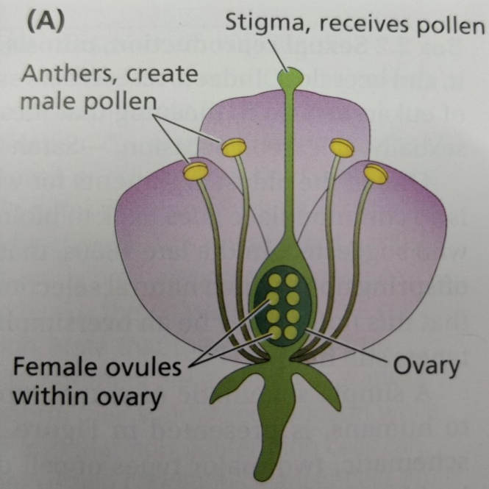

Mendelian Genetics
Mendel started expt. with Purebred
He crossed the characters and looked for the hybrids forms :

Slide 23







Mendelian Genetics
The forms of hybrids

Slide 24
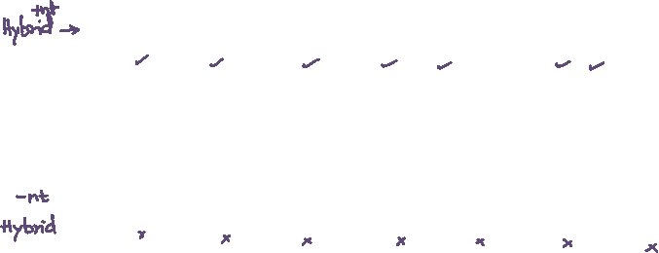
Mendelian Genetics
What did Mendel do?
He crossed the characters and looked for the forms of hybrids:

Slide 25
Mendelian Genetics
What have we learned so far?
Idea of blending as heredity was challenged.
Pair of discrete heredity factors/Pair of genes/ Allele/ alternate of same gene = Trait or Phenotype.
Character that is transmitted unchanged (entire): Dominant.
Character that is withdrawn in the hybrid:Recessive but reappears in their progeny (will see further).

Slide 26




Mendelian Genetics
What did Mendel do?
The forms of hybrids

Slide 27
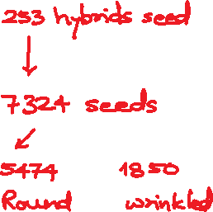


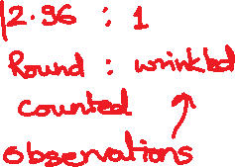
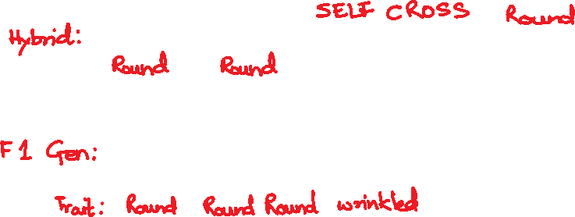

Mendelian Genetics

Slide 28

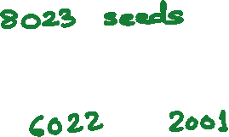


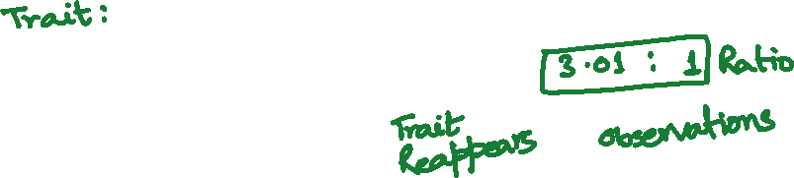





Mendelian Genetics

Slide 29
Mendelian Genetics
What did Mendel do?

Slide 30


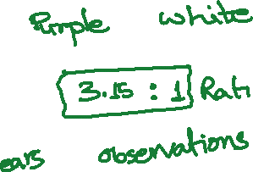
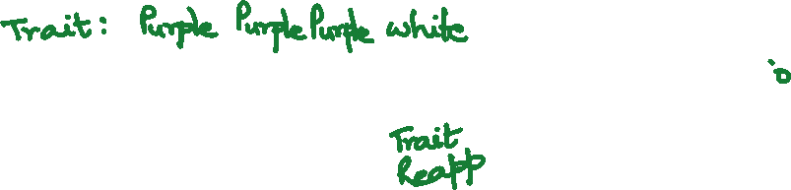

Mendelian Genetics
What did Mendel do?

Slide 31
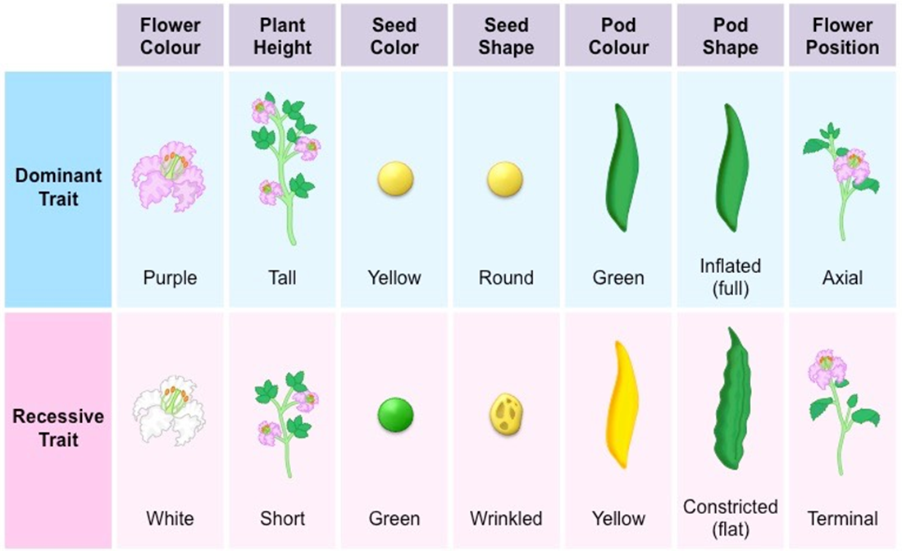




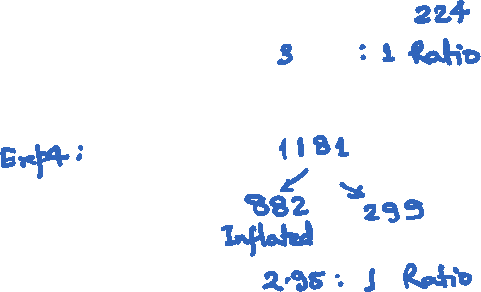
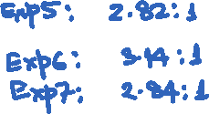
Mendelian Genetics
What did Mendel do?

Slide 32

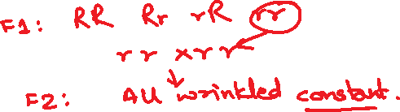



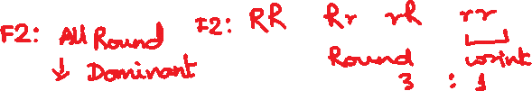

Mendelian Genetics
What did Mendel observed ?
Recessive character didn’t vary in second generation and remained constant.
Of the dominant character in the F1 Gen: One-third remains the dominant character constant. Two-thirds offspring display dominant and recessive characters in 3:1 ratio as hybrids.

Slide 33
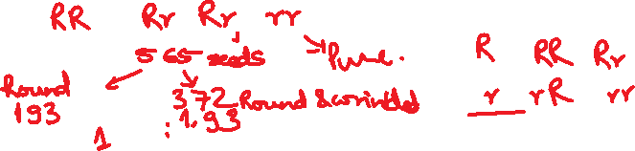

Mendelian Genetics
What did Mendel observed ?
NO Blending
Dominant: Character that is present in the hybrid.
Recessive: Character that is withdrawn in the hybrid but reappears in their progeny.
It was found that dominant and recessive characters had an average ratio of 2.98:1 or 3:1.
The dominant character have double significance: a) parental character (RR) or b) a hybrid character (Rr).

Slide 34
Mendelian Genetics
Conclusions from his experiments.
First Law : Traits come as discrete units
Law of segregation: two alleles for each trait separate during gamete formation and then unite at random, one from each parent, at fertilization.
Disproves Spermist theory: all information in sperm head.
Variation in phenotype: existence of alternate versions of genes. These versions are called alleles.
The alleles of each gene segregate, independently, one to each gamete.
Every individual inherits two alleles of each gene, i.e. one gamete from each parent.
If the alleles differ, one will be dominant and one recessive. Only the dominant trait will be expressed in the hybrid generation.

Slide 35
Mendelian Genetics
Conclusions from his experiments.
Second Law: Traits can be inherited independently from one another
Law of independent assortment: during gamete formation, the segregation of the alleles of one allelic pair is independent of the segregation of the alleles of another allelic pair. random,
Traits segregate independently; there is no linkage between genes for different traits. (∗Note: This is not always true.)

Slide 36
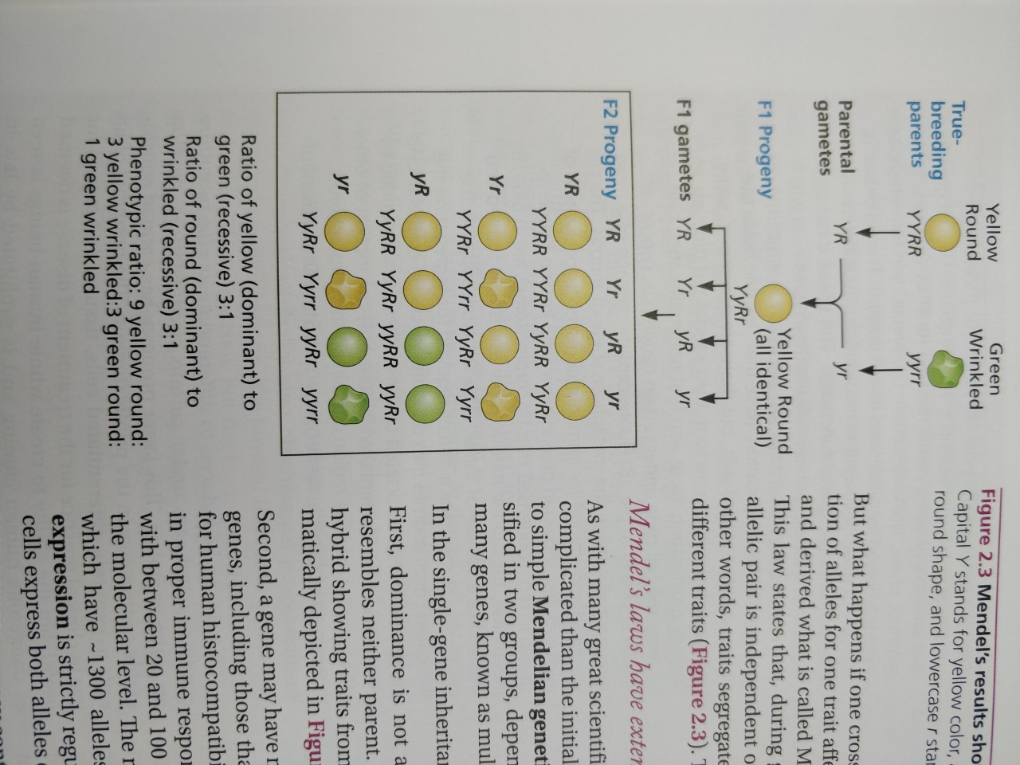

Mendelian Genetics
How two different traits would behave in hybrids?
Hybrid Gen
Hybrid gamete
F1 Gen
Hybrid Gen

Slide 37
Thank You!

Slide 38
Type of Questions
If a couple already have 3 daughters, what is the probability of them have a son?
Classify the following heterozygous or homozygous: RR, Rr, yy, YyRR.
What is the phenotype of the following: Yy, Rr, yy, YyRr.
What is the probability of Rr X Rr producing wrinkled seeds?
What is the probability of Yy X yy producing green seeds?
What is the probability that RrYy X RRYy would produce RrYy?
Round (R) is dominant to wrinkled (r). Yellow (Y) is dominant to green (y)

